Slide 1
Film & TV Tracker Project

Slide 2
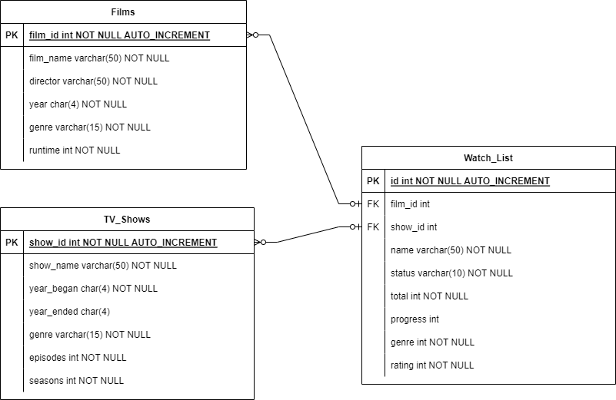
ER DIAGRAM

Slide 3
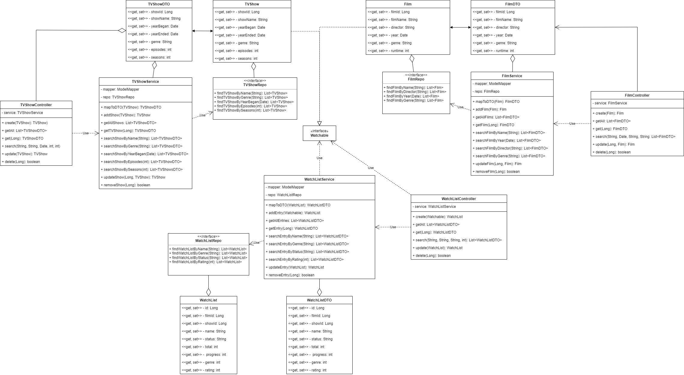
CLASS DIAGRAM ver 1

Slide 4
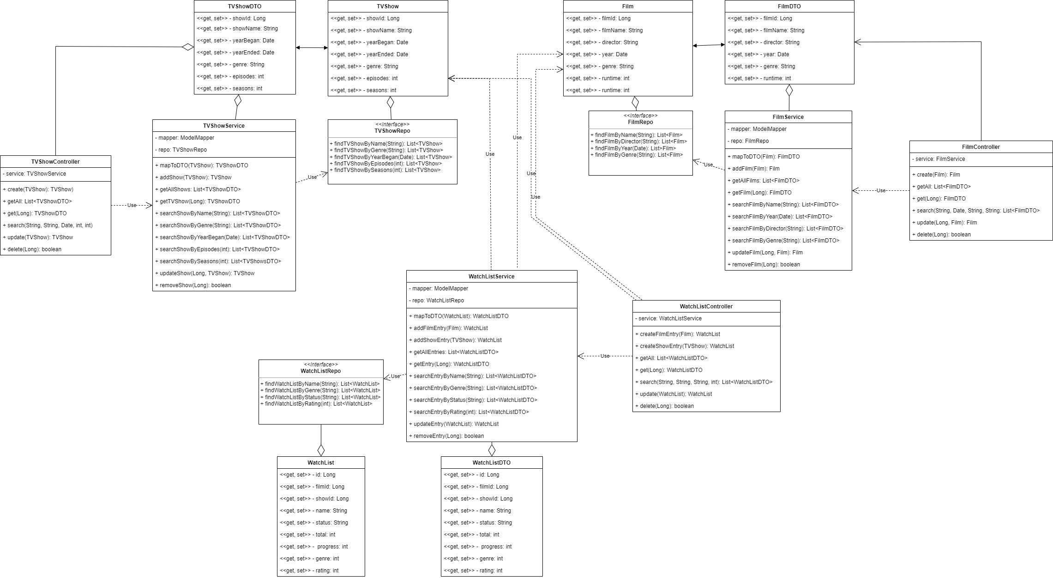
Class diagram ver 2

Slide 5
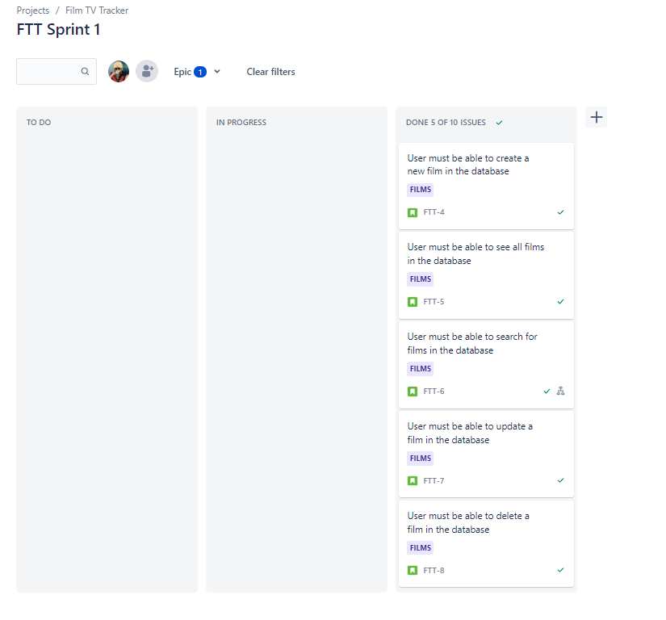
Jira board: Film epic

Slide 6
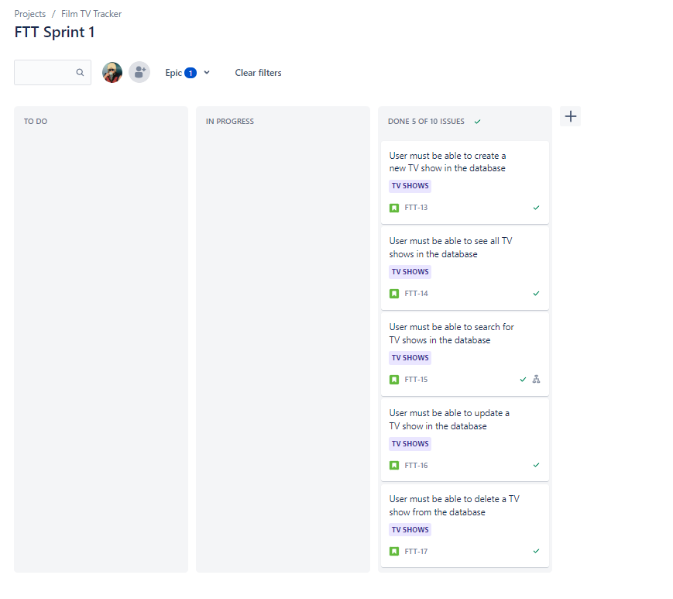
Jira Board: TV Show epic

Slide 7
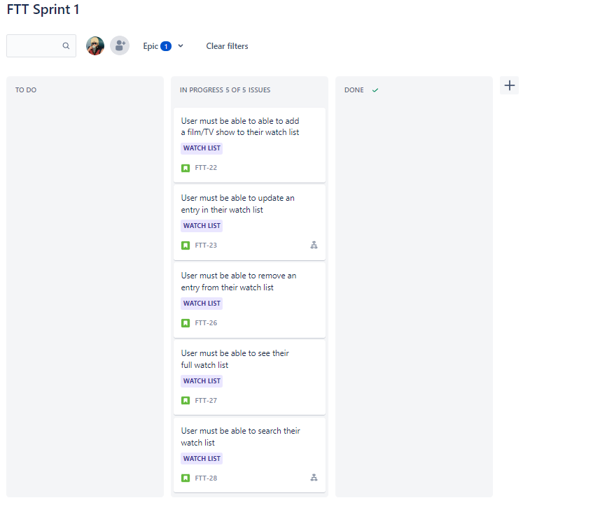
Jira Board: Watch List epic

